Slide 1
Online Training via SuccessFactors
Search, Select, Self Assign, and Register

Slide 3
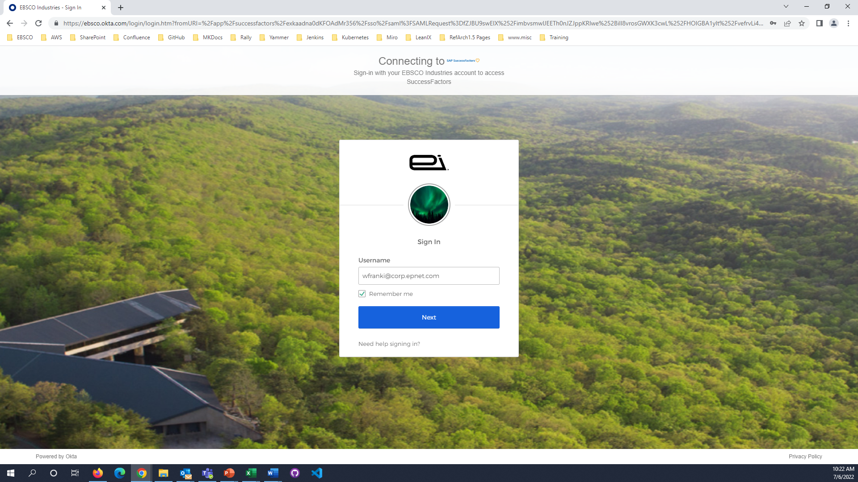

Login to your OKTA page

Slide 4
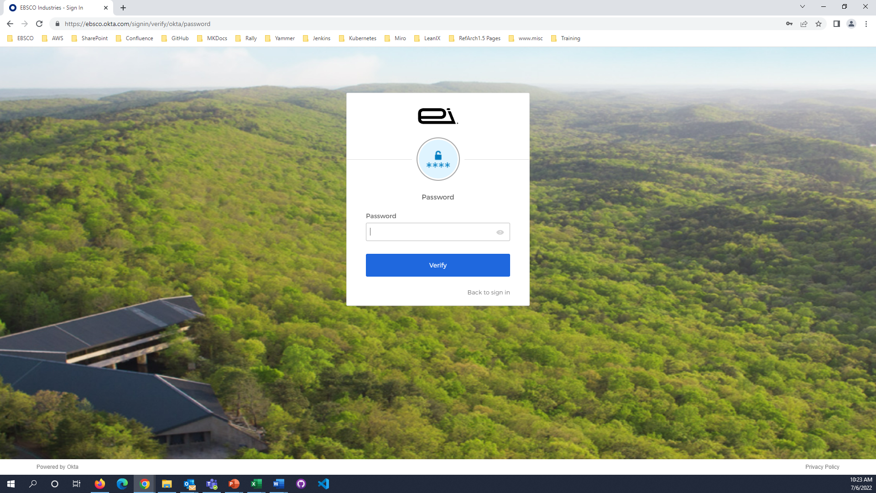
Login to your OKTA page

Slide 5
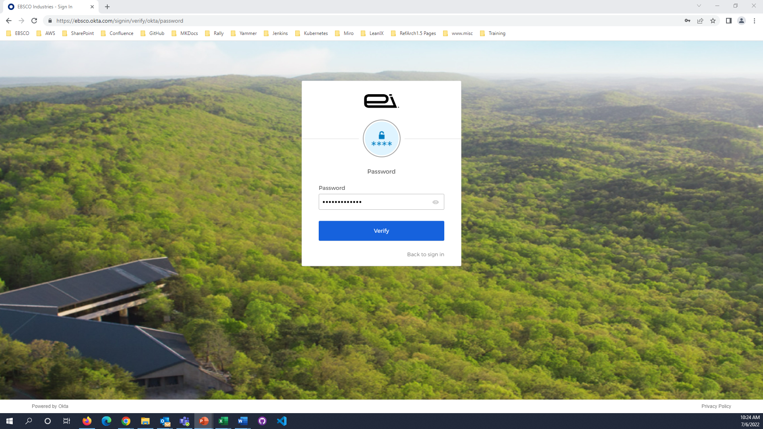
Login to your OKTA page

Slide 6
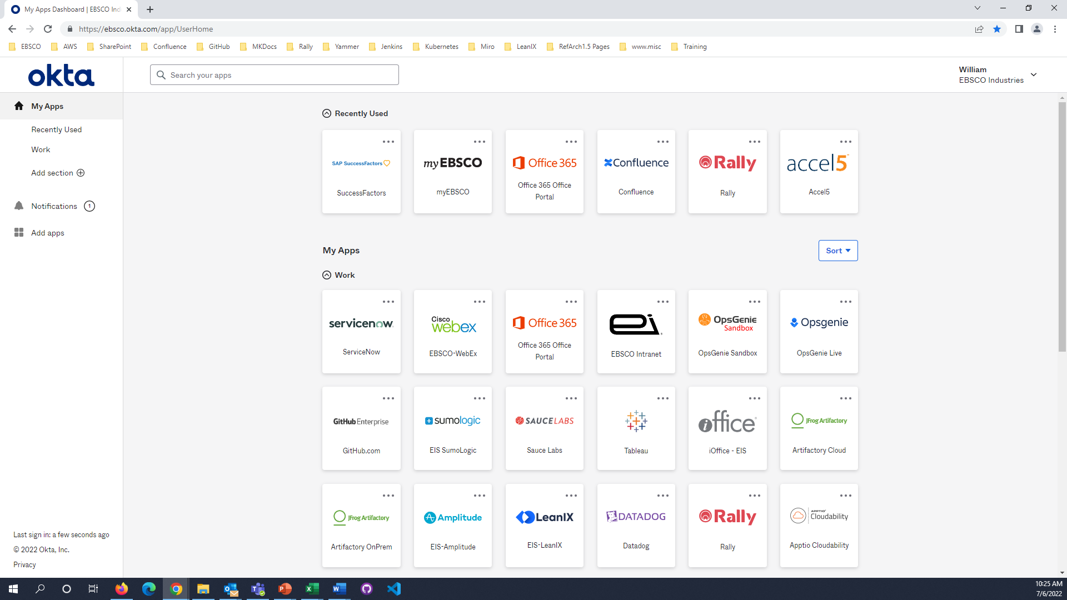
Login to SuccessFactors

Slide 7
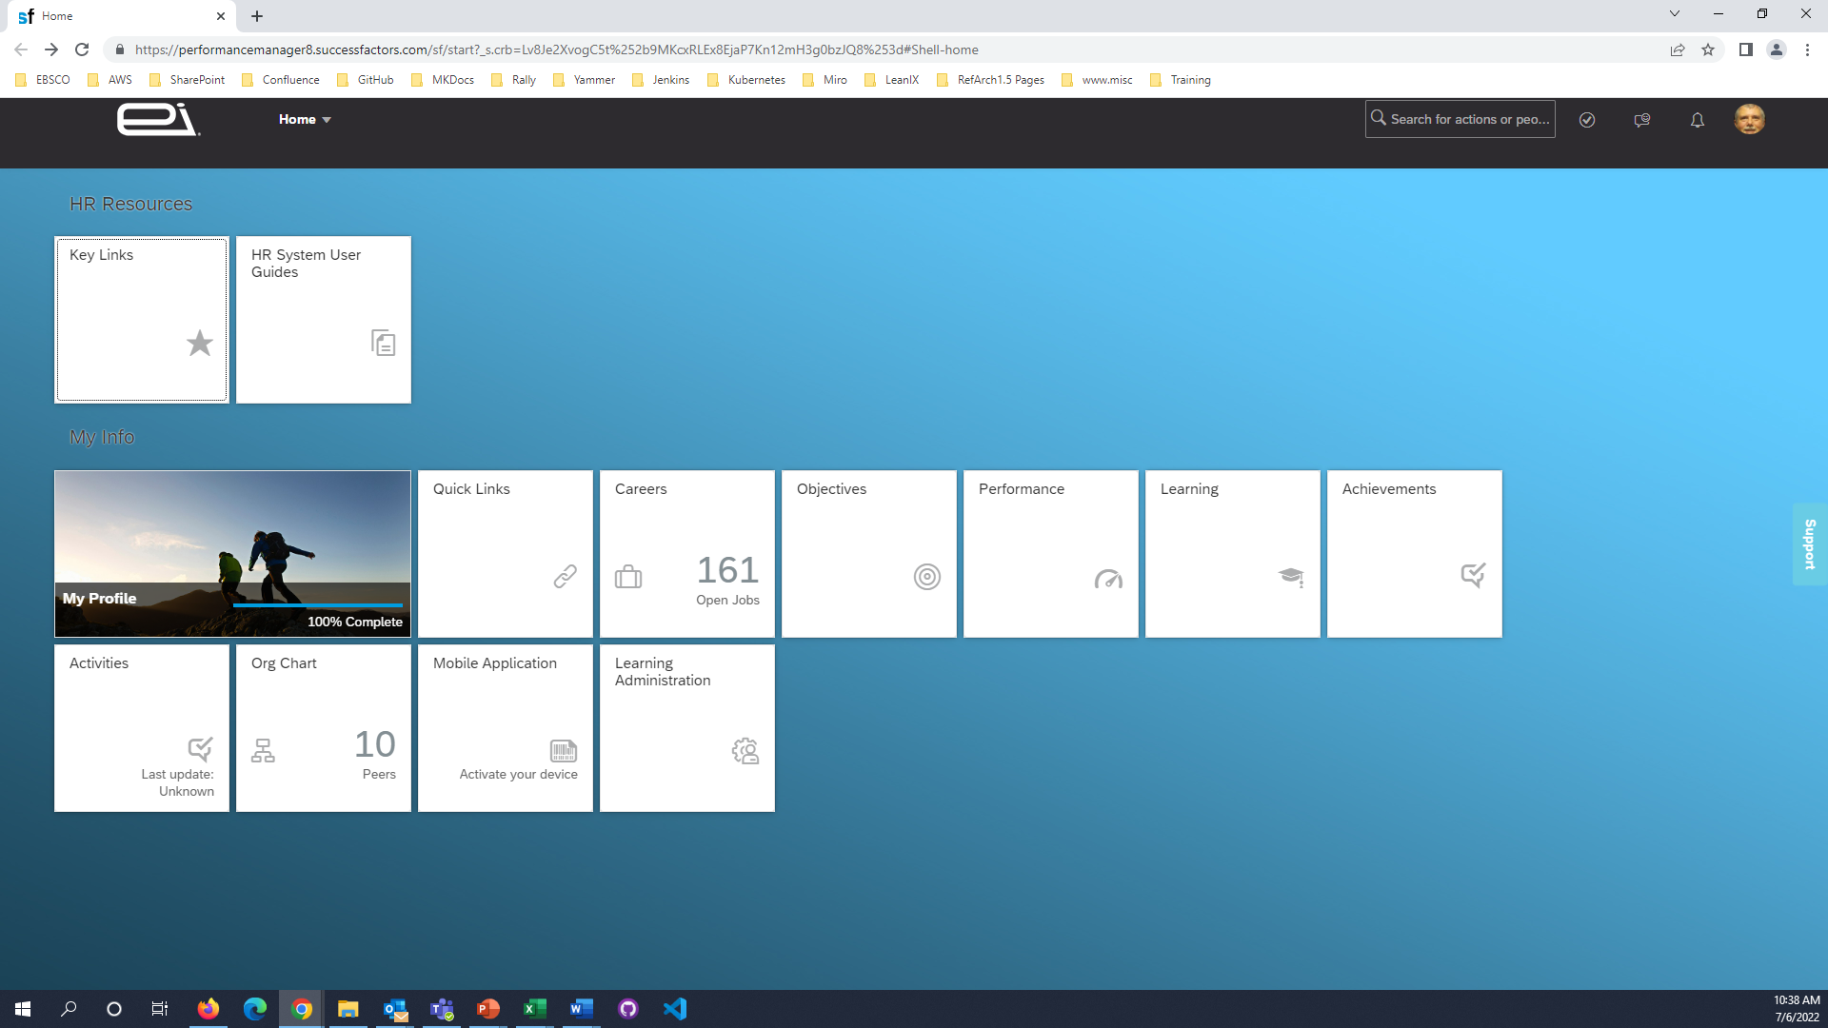
Click the Learning button

Slide 8
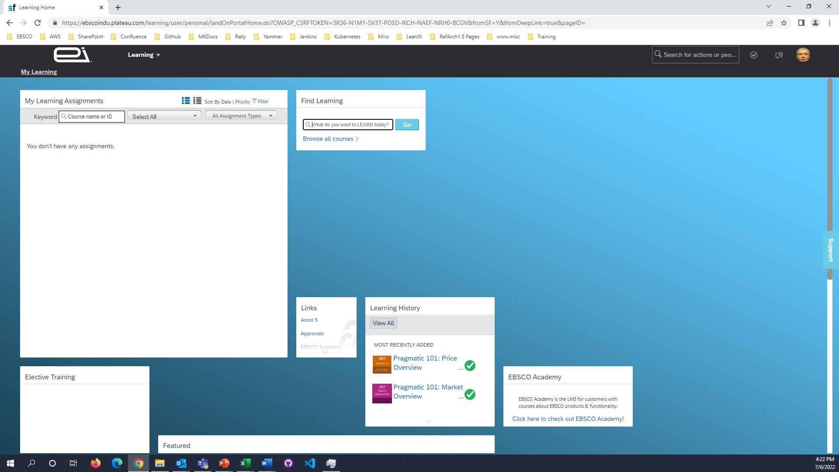
Click in the Find Learning field and start typing the title want to take

Slide 9

Select the course you want to
register for from the dropdown list

Slide 10
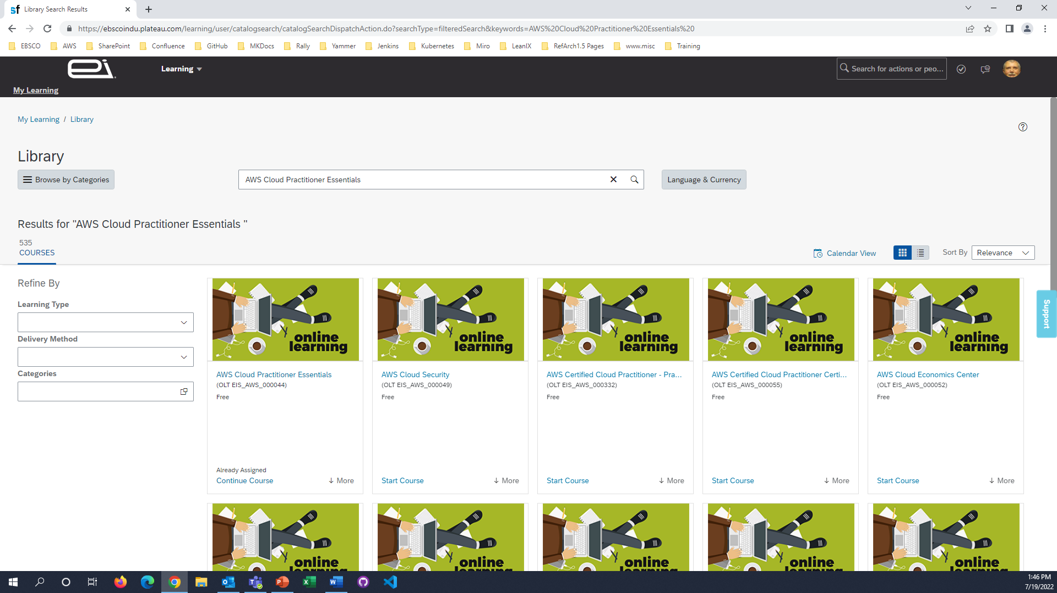
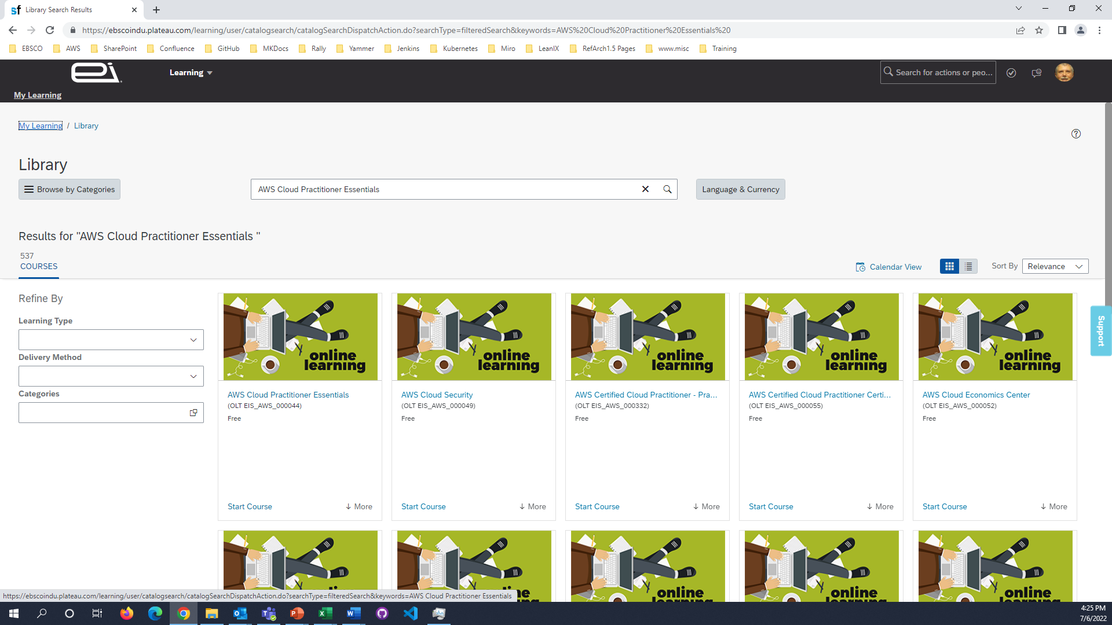
Choose your desired course from the search results

Slide 11
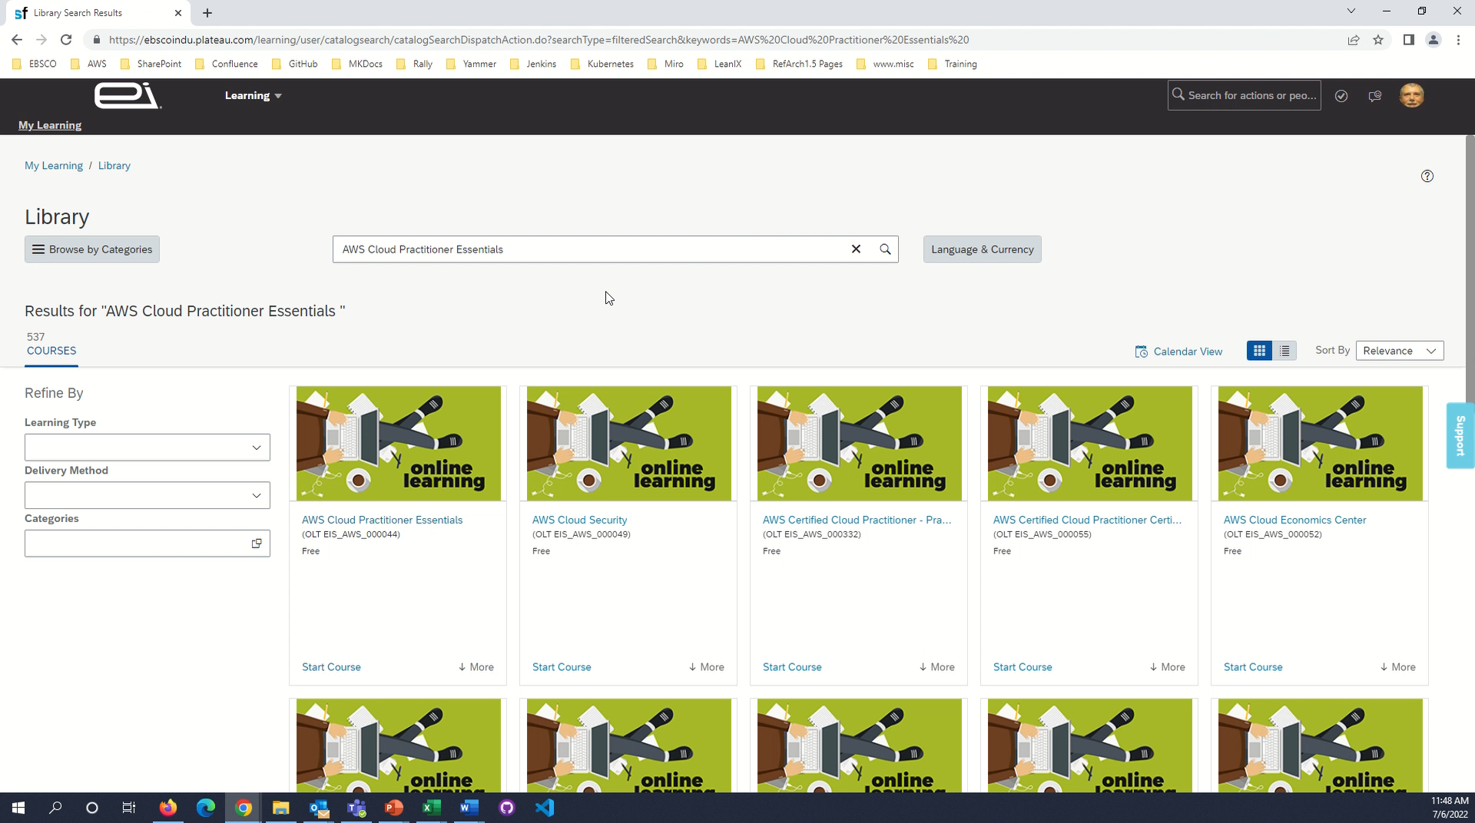

Slide 12
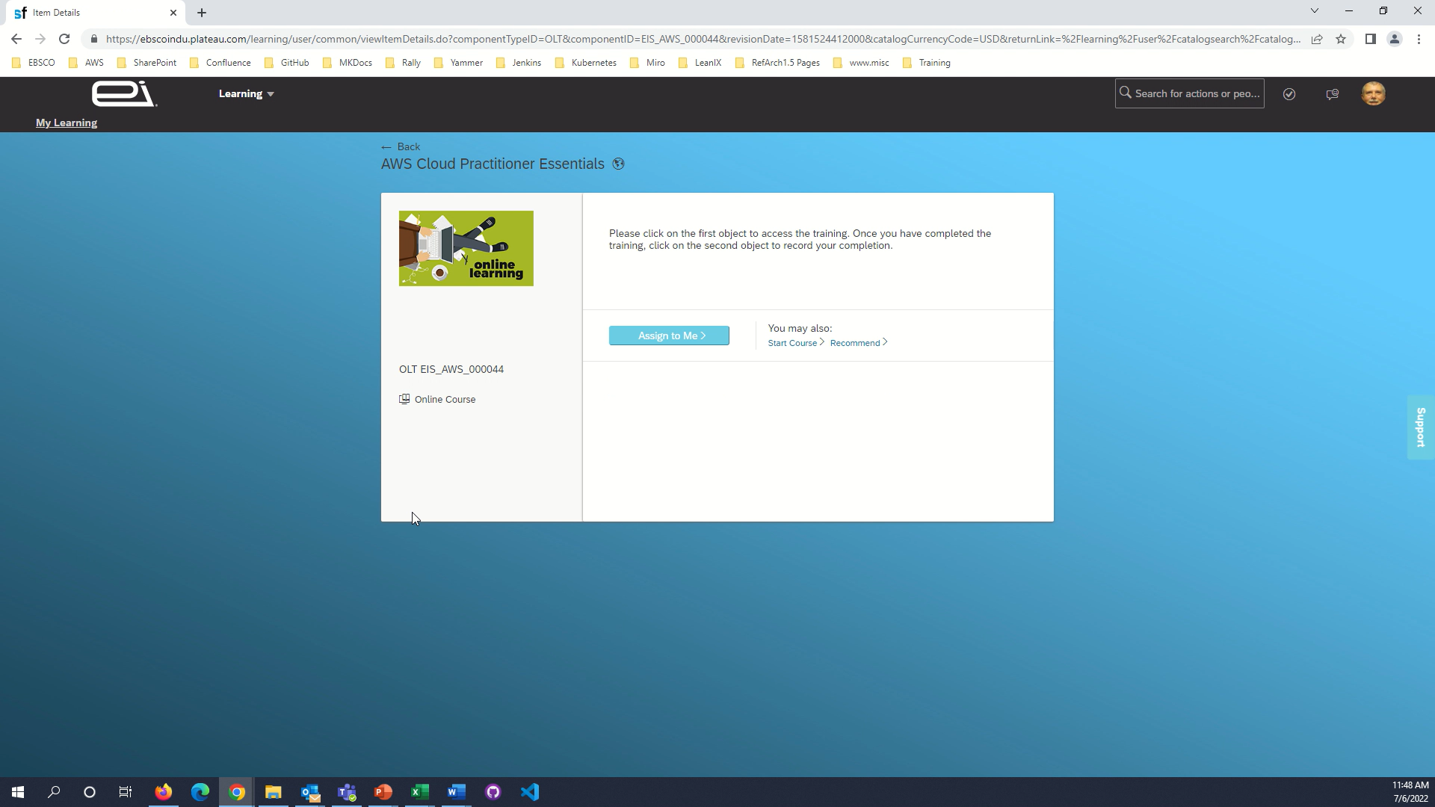
Click Assign to Me >

Slide 13


Slide 14

Click Start Course >

Slide 15
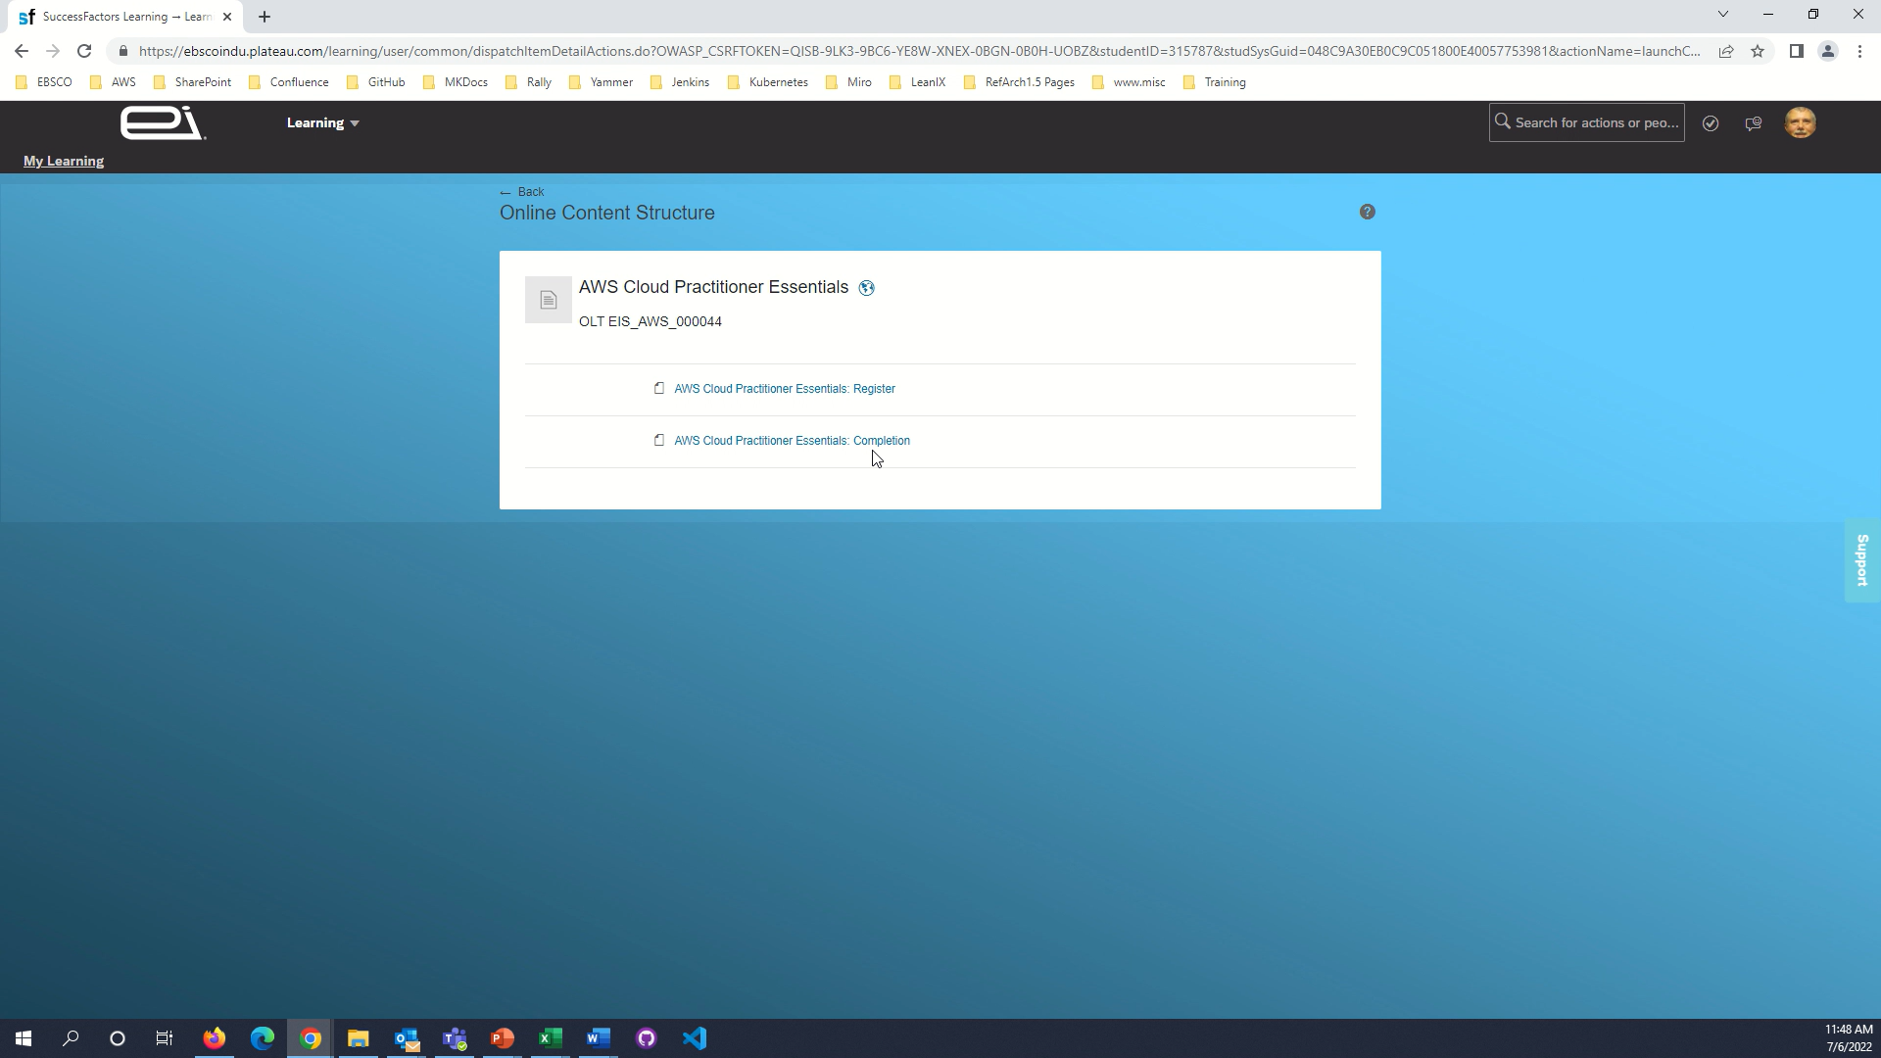
Click AWS Cloud Practitioner Essentials: Register

Slide 16
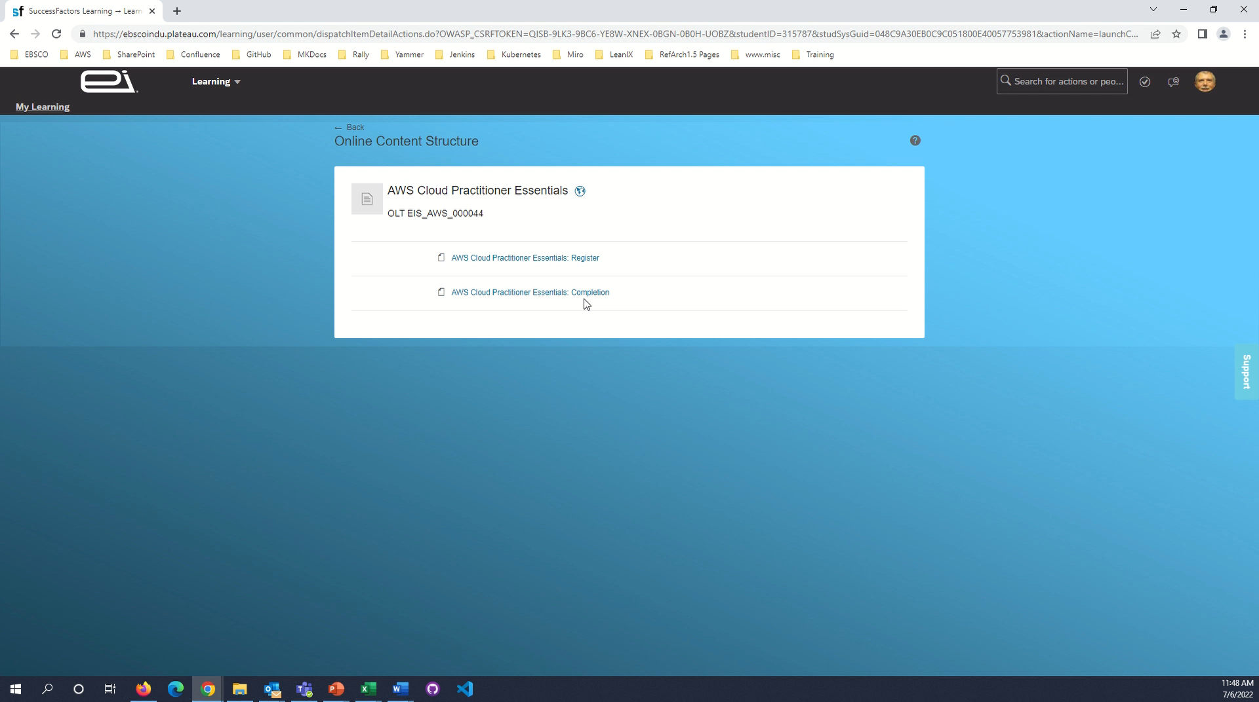

Slide 17
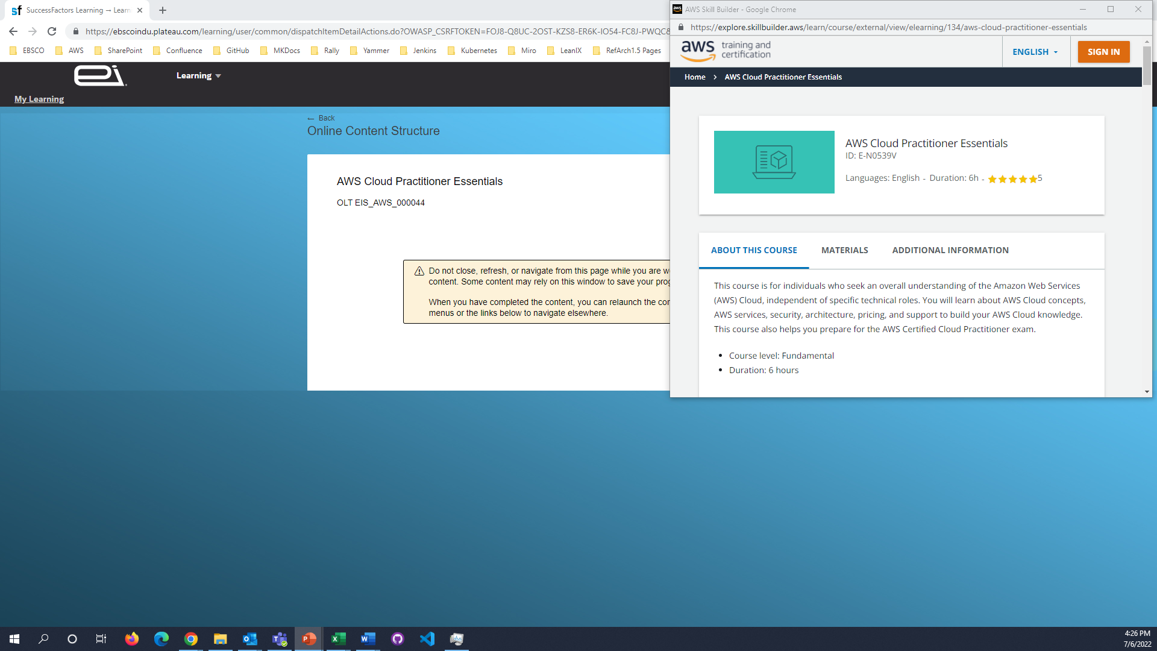
Click Sign In

Slide 18
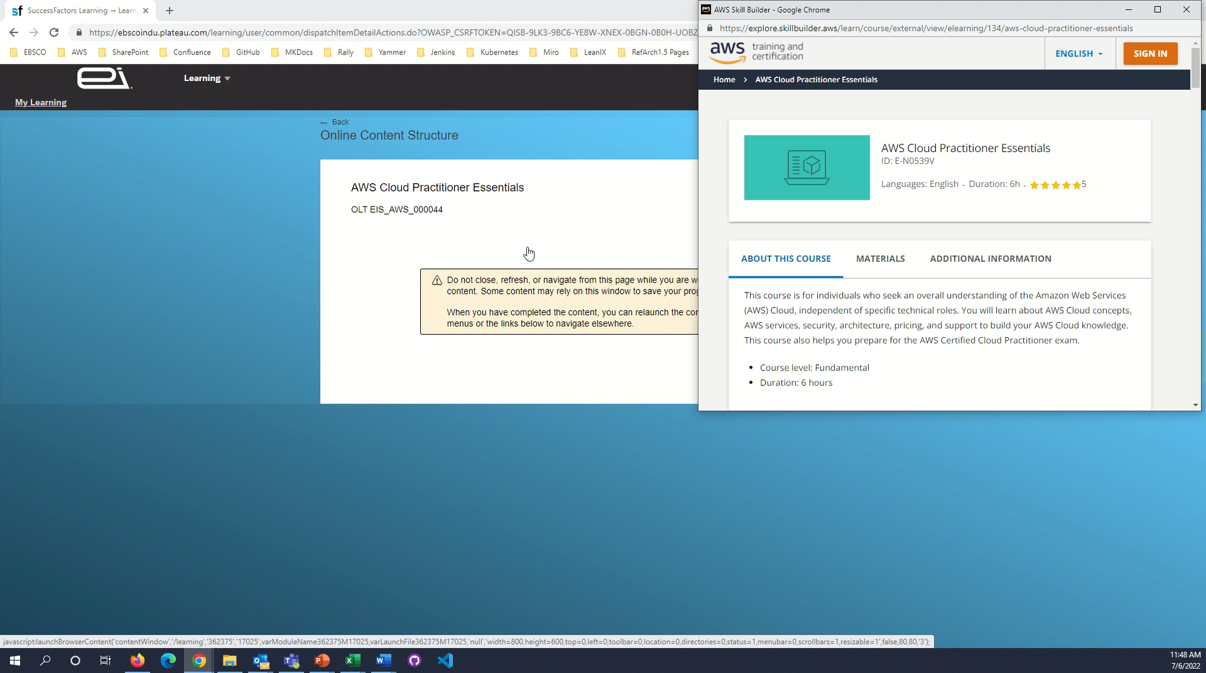
Click Sign In

Slide 19
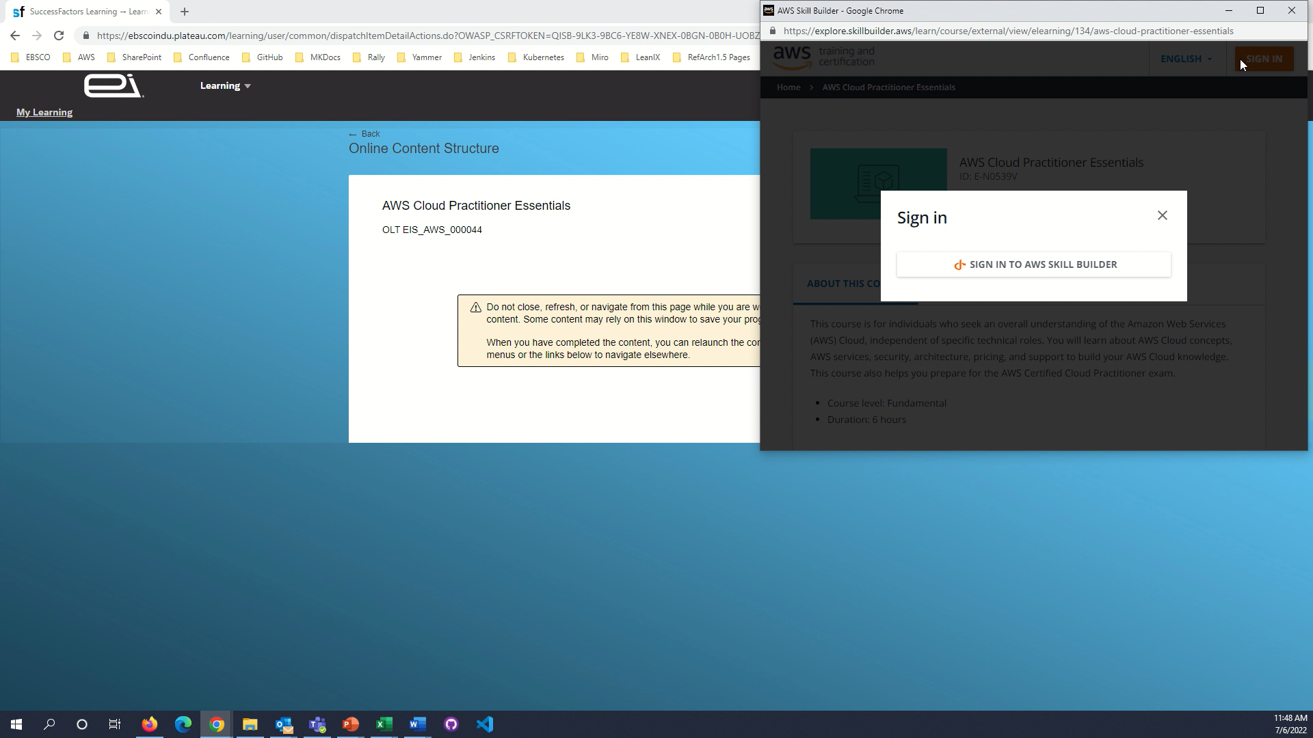
Click SIGN IN TO AWS SKILL BUILDER

Slide 20


Slide 21
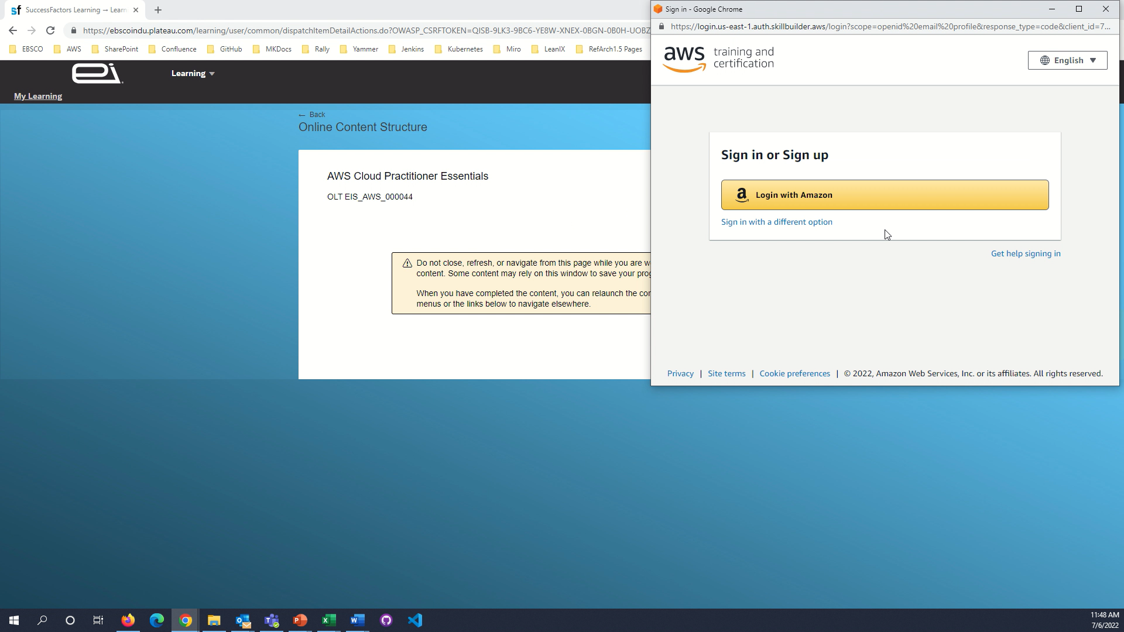

Slide 22
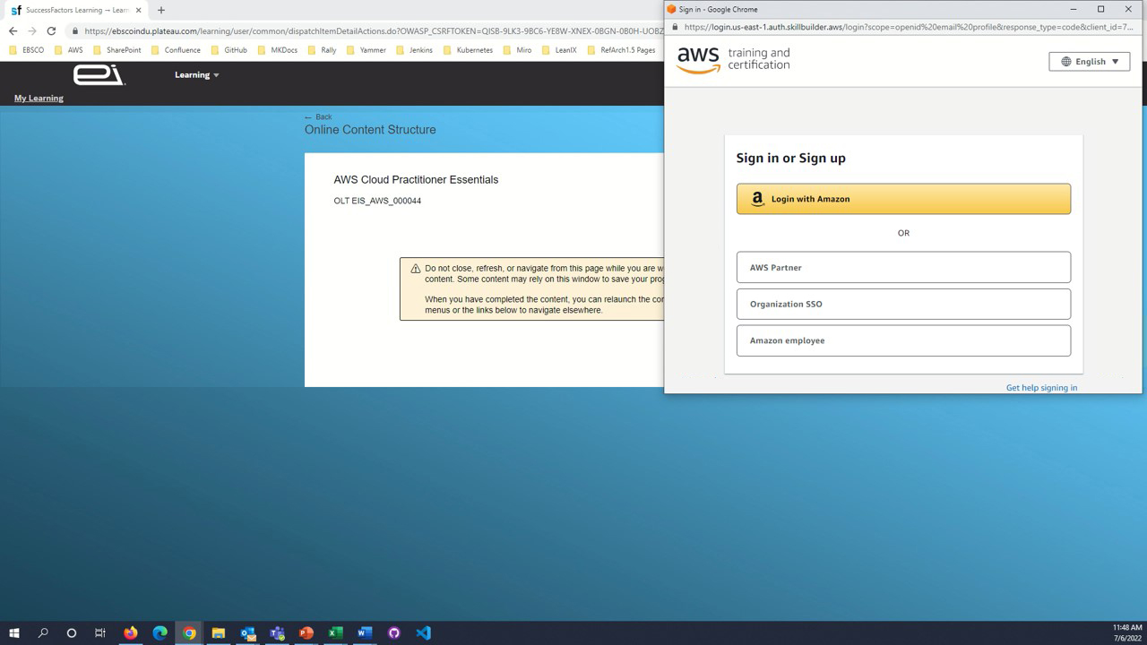

Slide 23
Click Login with Amazon

Slide 24


Slide 25
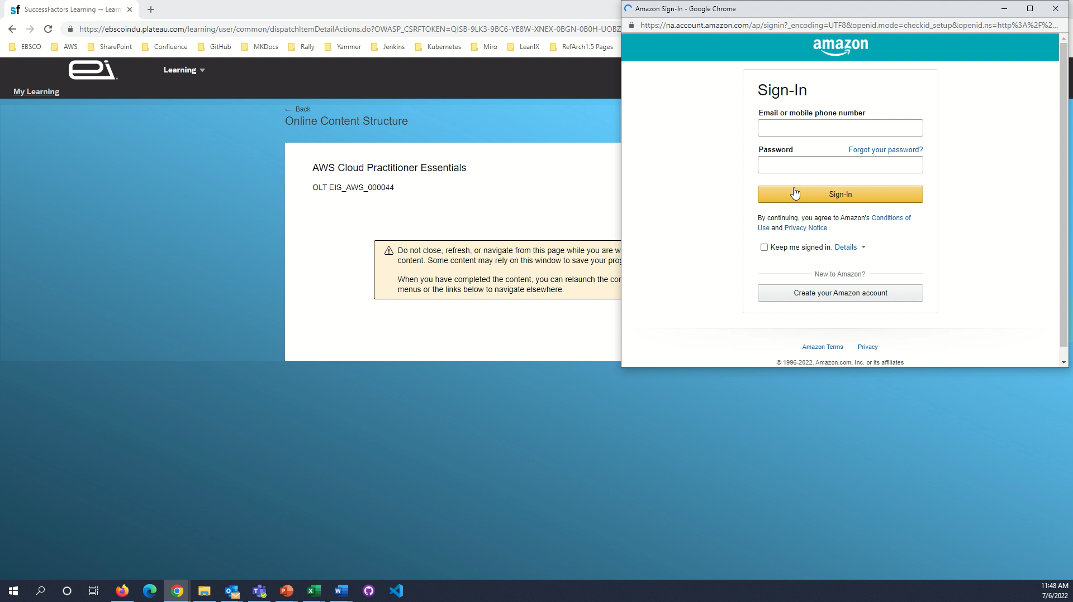

Slide 26

Use your ebsco.com
Amazon
account to sign in

Slide 27

Use your ebsco.com
Amazon
account to sign in

Slide 28
If required, create an ebsco.com
Amazon
account

Slide 29


Slide 30
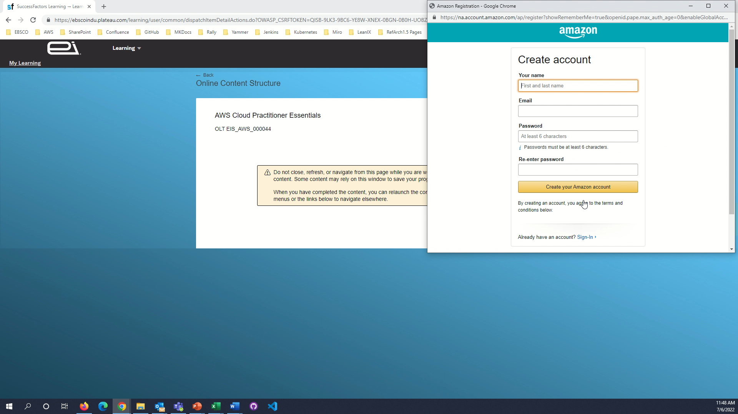



Slide 31


Slide 32
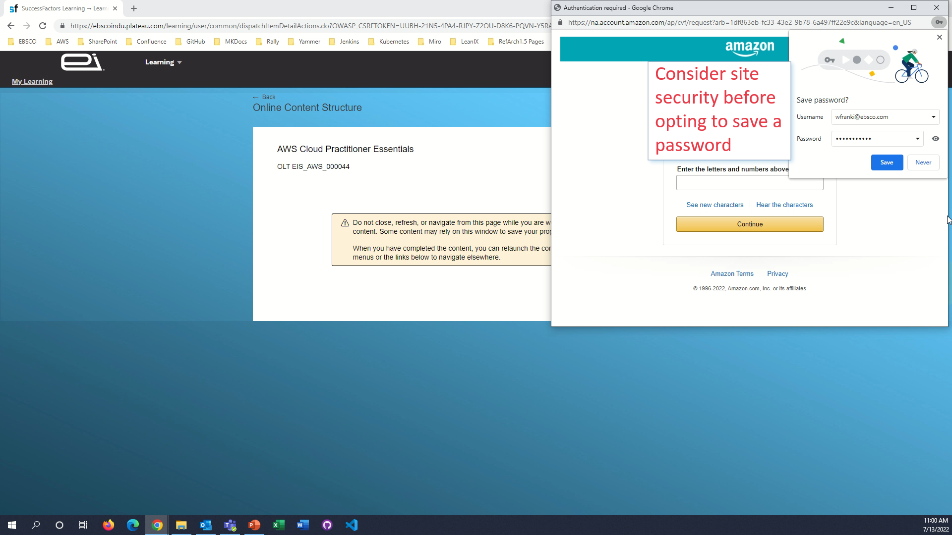

Slide 33
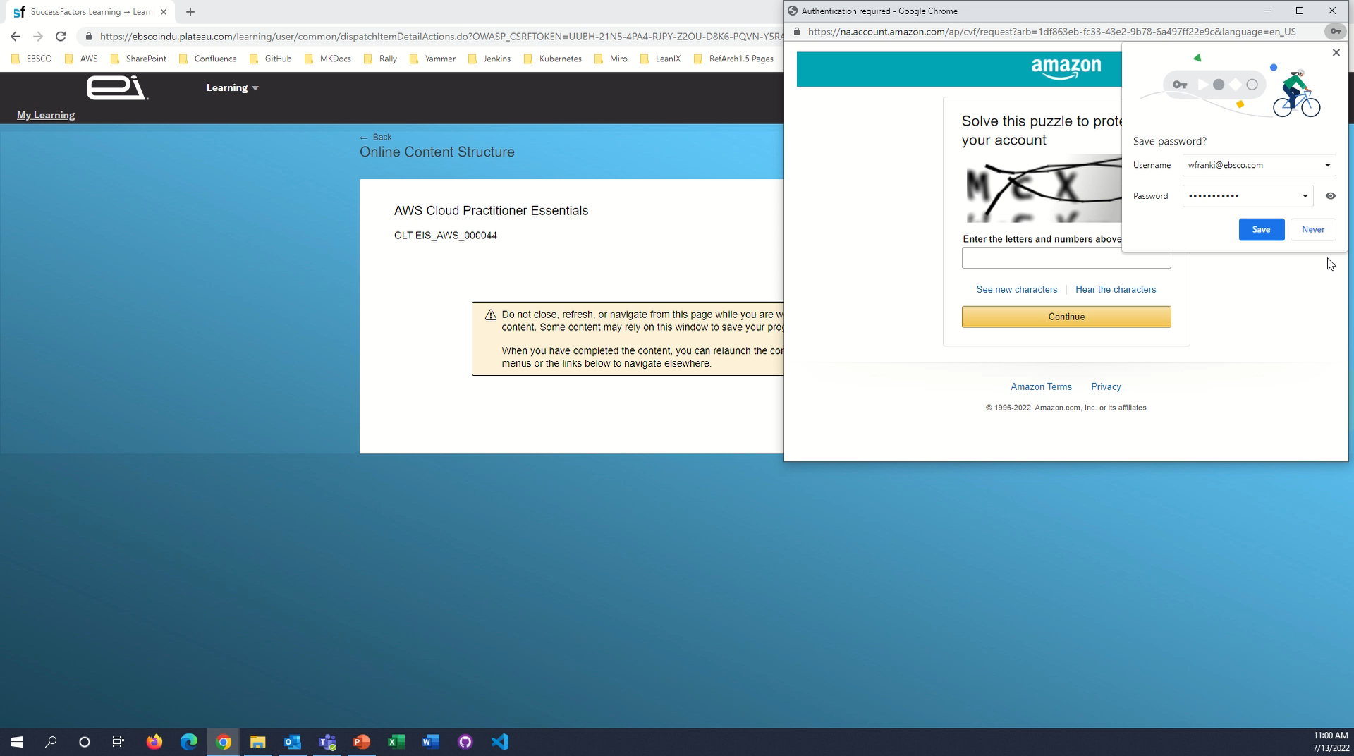

Slide 34
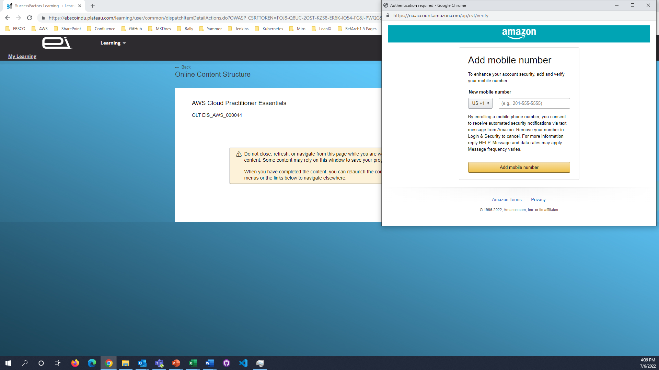

Slide 35


Slide 36


Slide 37


Slide 38
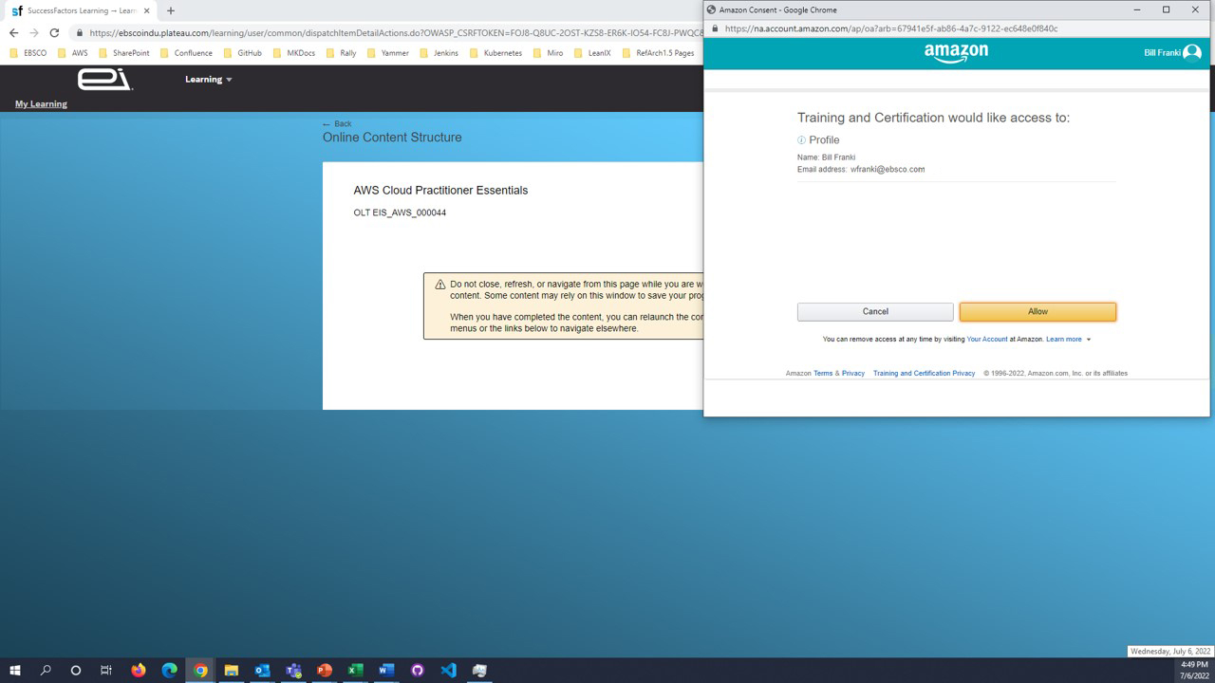
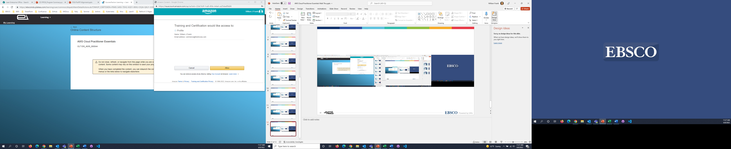

Slide 39
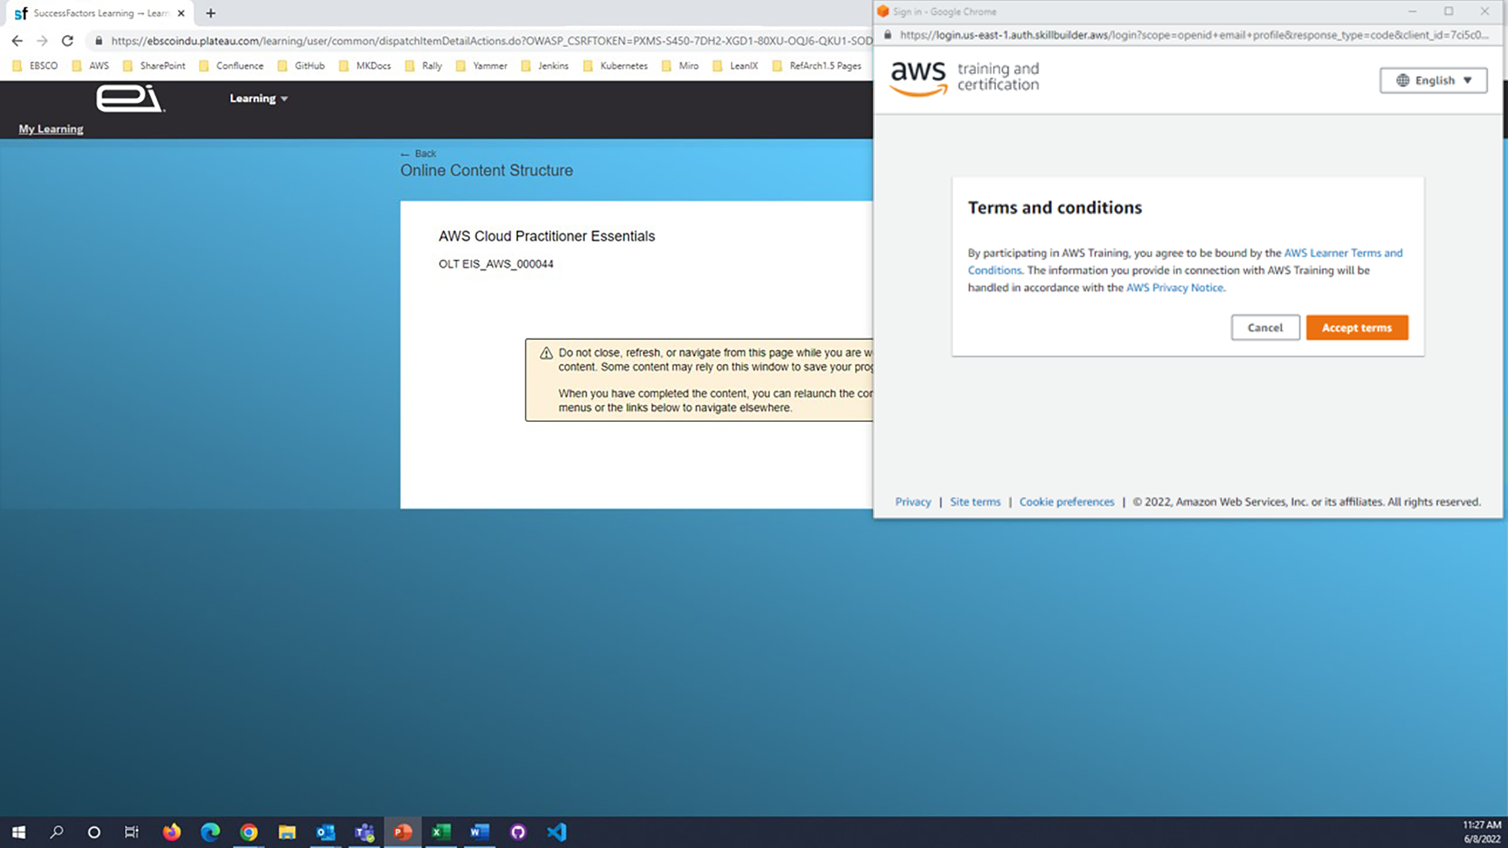

Slide 40
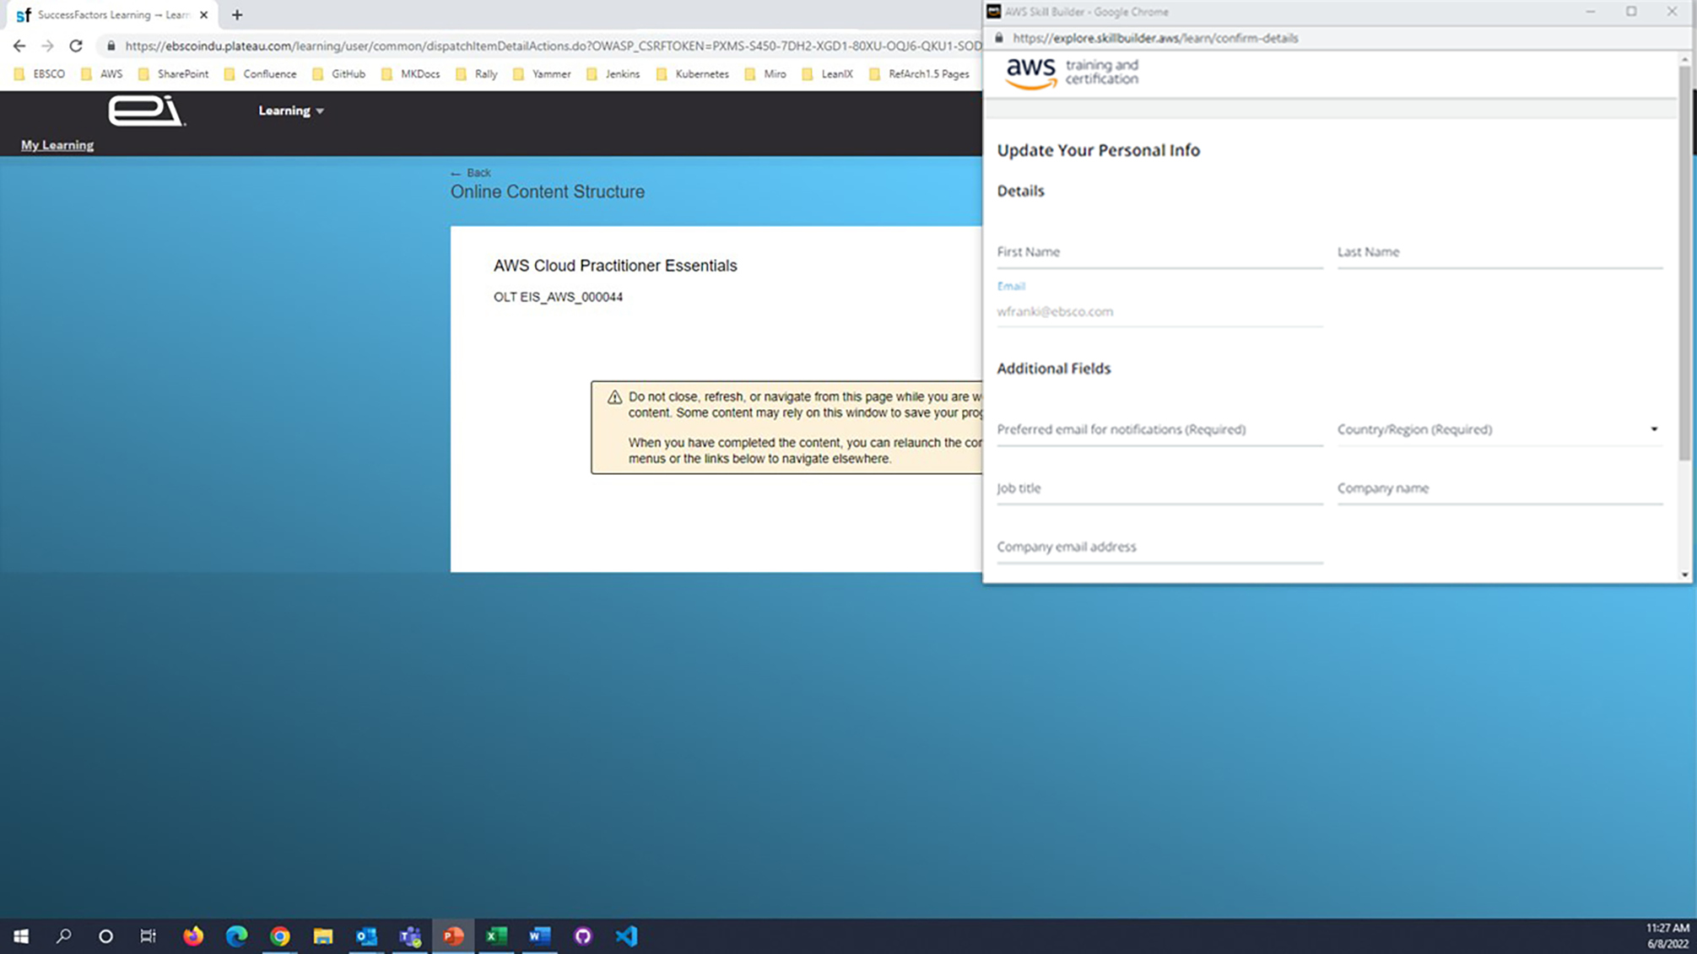
Add your personal info

Slide 41

Click CREATE ACCOUNT

Slide 42
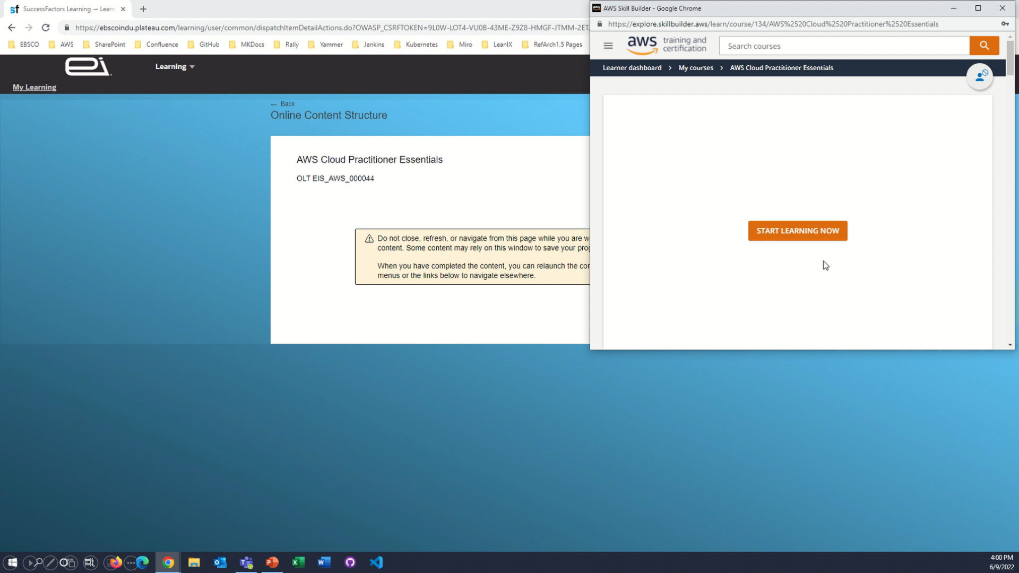

Slide 43
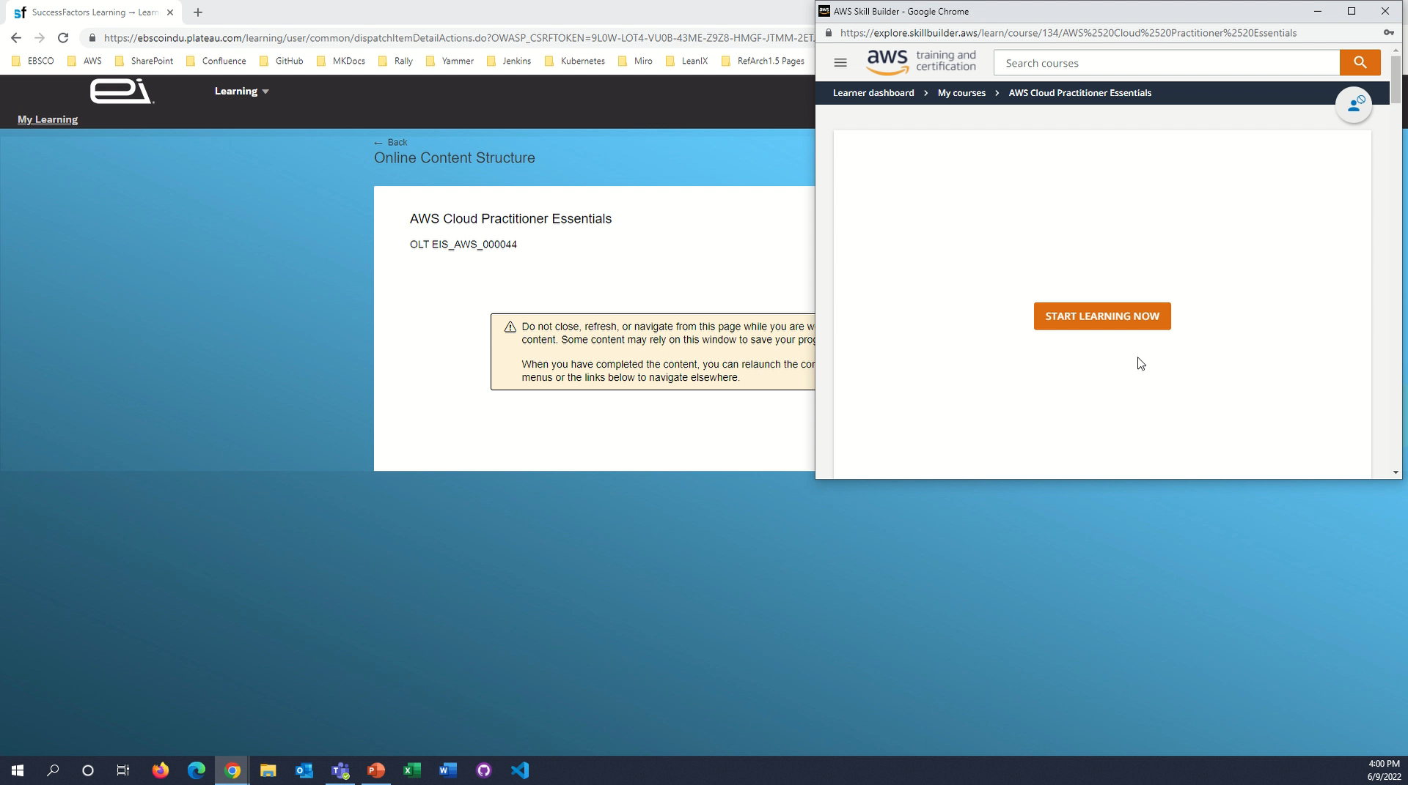

Slide 44
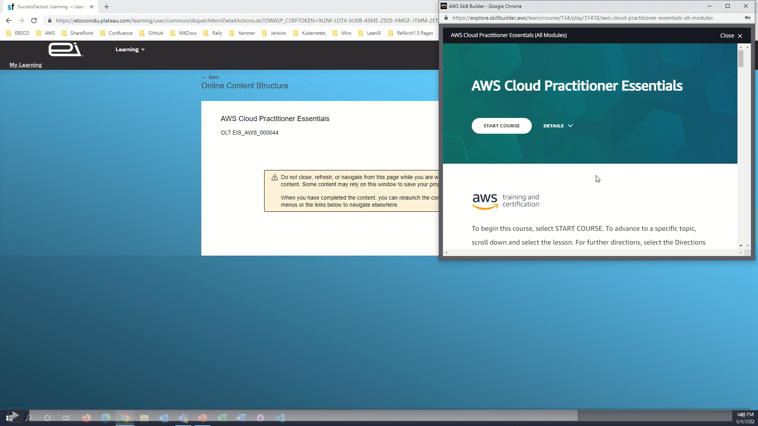
Click START COURSE to begin

Slide 45
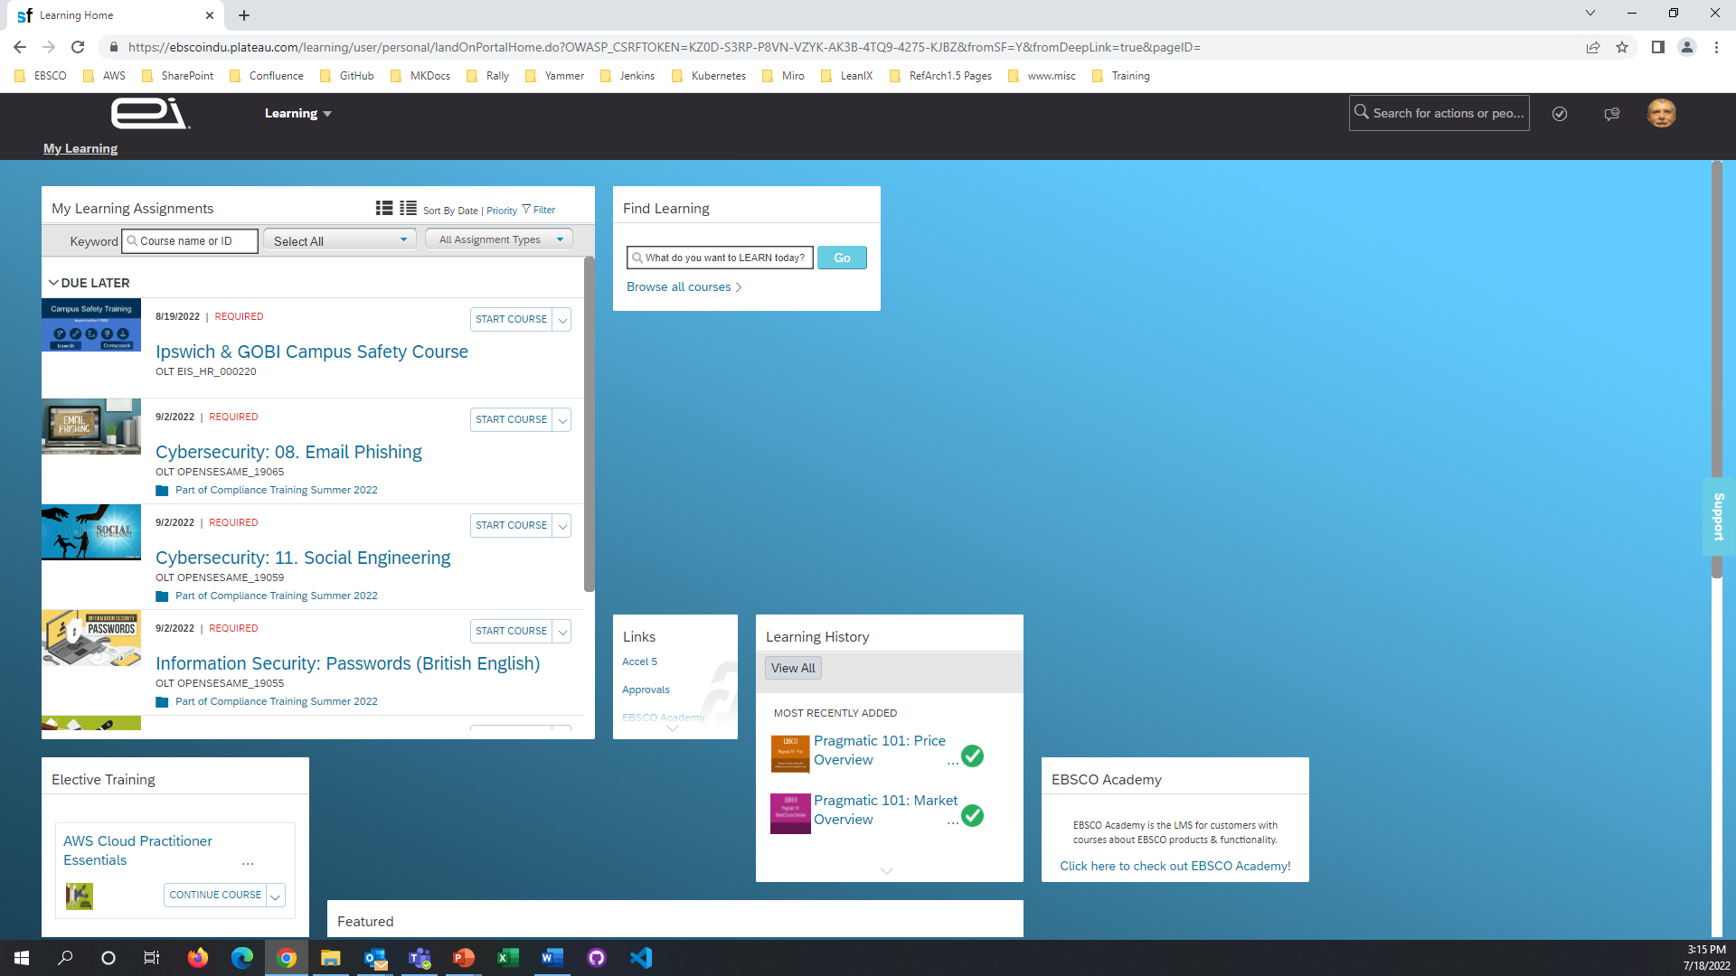
AWS Cloud Practitioner Essentials now appears in Elective Training

